Slide 1
CSE 291: Project Presentation
Classification of Covid-19 and Non-Covid-19 samples using Proteomics data
Balaji Muthazhagan, Keerthana Sundaresan, Prajwala Thatha Manjunatha,
Sanjana Balamurugan

Slide 2
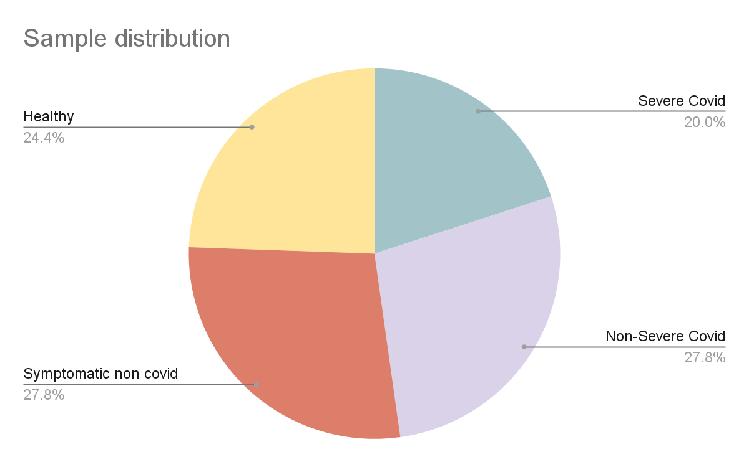
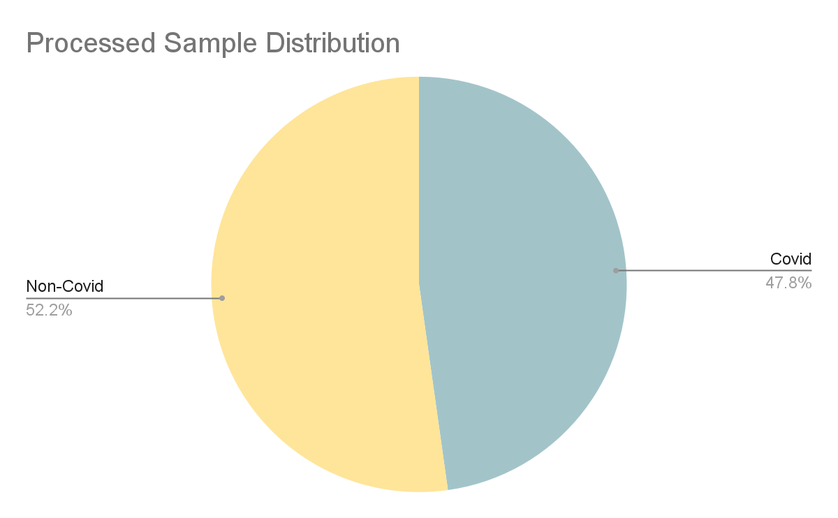
Pre-processing
Only use columns with “[patient_condition]..intensity_for_peptide_variant”, dropping two samples (Empty and Norm)
Transpose the matrix
Add column Original Class - original condition of the sample (4 from dataset)
Add column Condition - “Covid” and “No-Covid” - Our Task!
Notes:
Data is already balanced, analyzed sample distribution

Slide 3
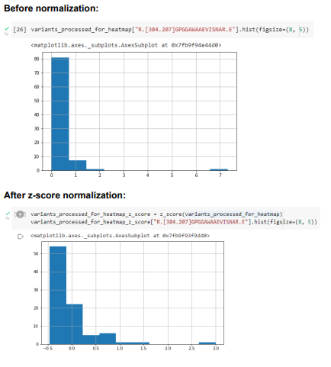
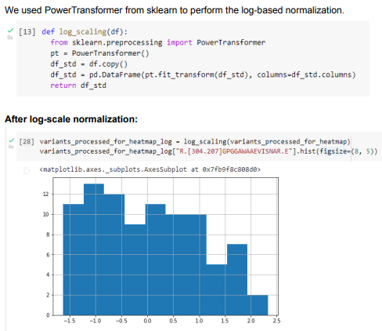
Experimenting with normalization

Slide 4
Model
Model: Random Forest classifier model using RandomForestClassifier from sklearn
Task: Classify condition of patients into COVID19 and Non-COVID19 classes
Hyperparameter Tuning: RandomizedSearchCV module for hyperparameter tuning based on parameters such as # of estimators (trees), max # of features at every split, max depth of tree
Why this model?: Robust against overfitting to train data; relevant for this classification task
Advantage over other models: Attribute high importance to feature selection in learning - advantage over KNN or SVM

Slide 5
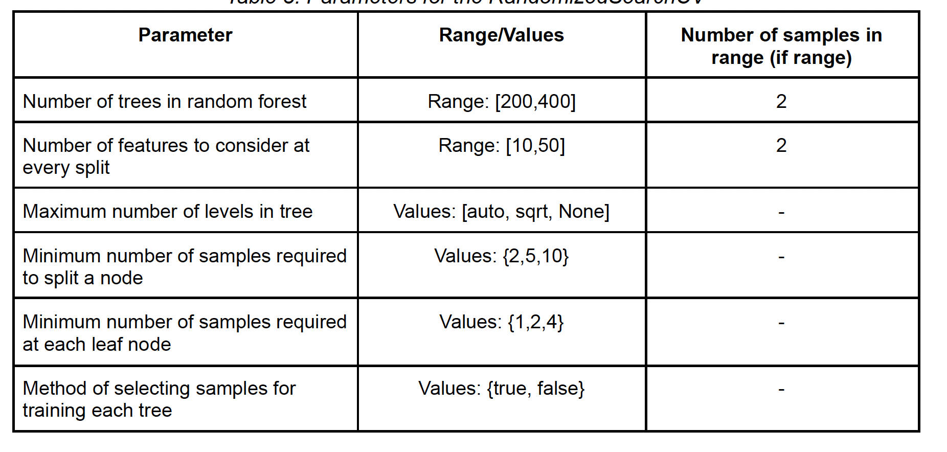
Evaluation of the model
Train-test split: 70:30
Validation strategy: K-fold Cross validation, K = 3
Dataset split: 70:30 on each of the classes for uniform distribution of classes
Hyperparameter selection and tuning: Randomized grid search using sklearn’s RandomizedSearchCV module
Notes:
Model 1- higher false negatives
model 2 - higher false positives

Slide 6
Results
Strategy | #Features | Accuracy | F1-Score | Precision | Recall
Drop all peptides with NAs | 10634 | 0.87 | 0.87 | 0.83 | 0.91
Remove highly correlated features | 831 | 0.84 | 0.83 | 0.8 | 0.87
Drop 10% max NAs, z-score norm, impute with mean | 100185 | 0.84 | 0.84 | 0.8 | 0.89
Drop 10% max NAs, log-scale norm, impute with mean | 100185 | 0.89 | 0.9 | 0.82 | 1
Drop peptides with all NAs, impute with MissForest | 101464 | 0.89 | 0.88 | 1.00 | 0.80
Model 2
Model 1
Notes:
MissForest:
Drop cols with all NAs (90)
Form clusters based on canonical protein
Use the MissForest algorithm to impute missing values (RF imputer which takes col with least number of missing values and imputes; then for second least, and so on)
We do this for train data

Slide 7
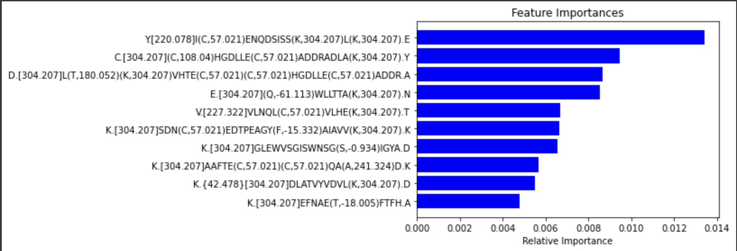
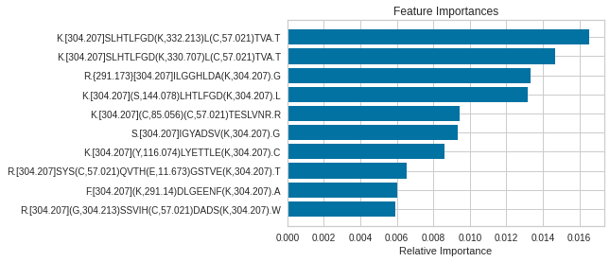
Assessment on important features for the classification
Top features selected by model:
Model 1
Model 2

Slide 8
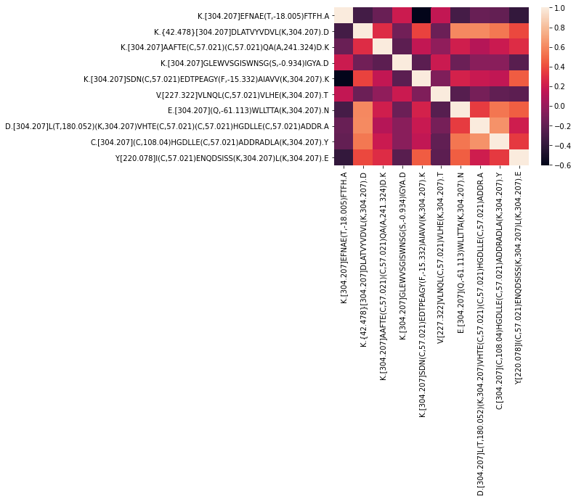
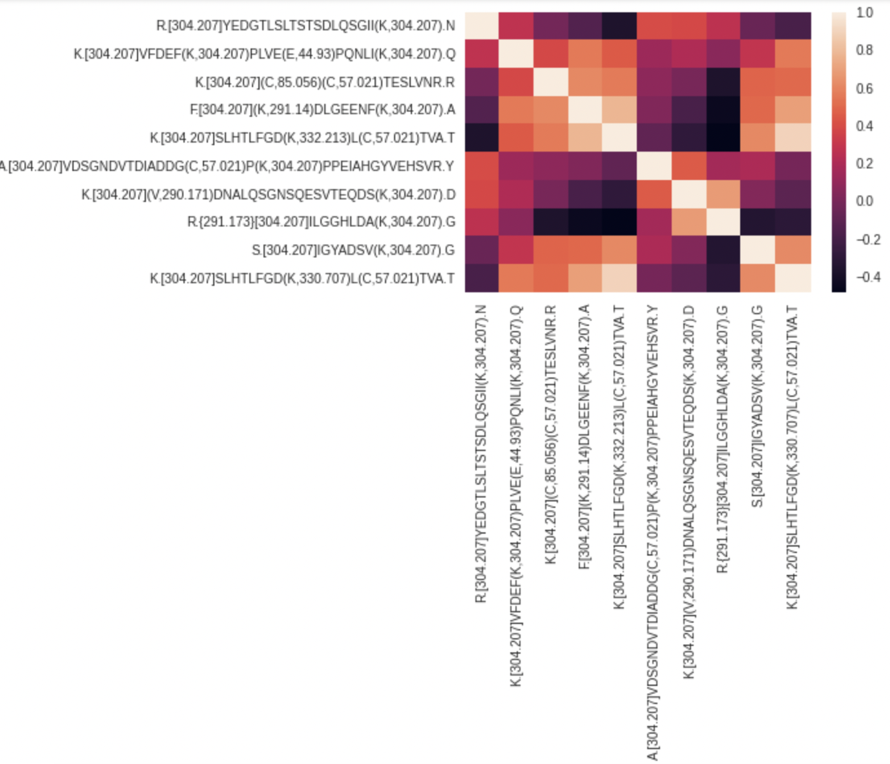
Assessment on important features for the classification
Correlation heatmap among top 10 features Model 1:
Model 2:
Notes:
Model 1 - good correlations - 0 - 0.5
Model 2 - high positive or negative correlation

Slide 9
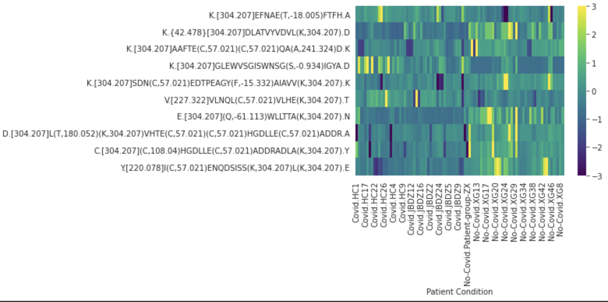
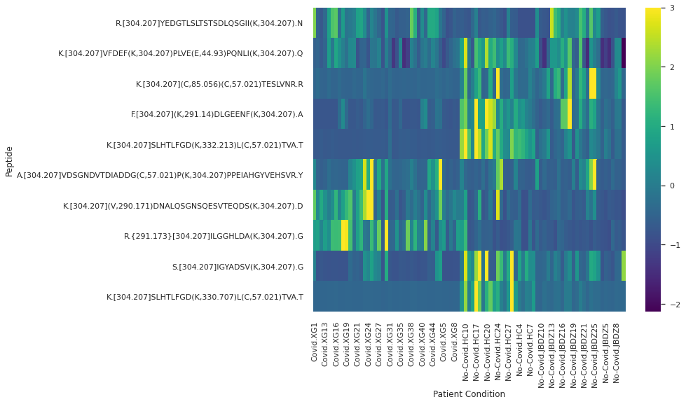
Assessment on important features for the classification
Feature intensities across patients:
Model 1: Model 2:

Slide 10
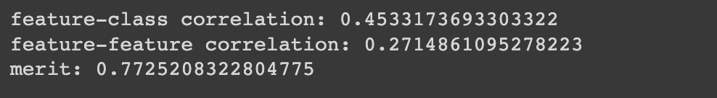
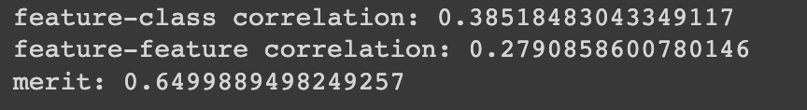
Assessment on important features for the classification
Correlation metrics for top 10 features:
High feature-class correlation
Low feature-feature correlation
High merit
Model 1:
Model 2:

Slide 11
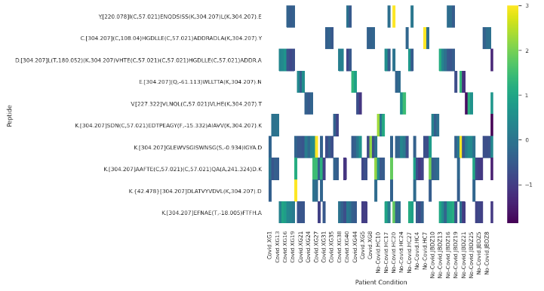
Disease and class association - Model 1
Peptide | T-test | Mann-Whitney rank test | Wilcoxon Rank Sum test
K.[304.207]GLEWVSGISWNSG(S,-0.934)IGYA.D | 0.99 | 0.87 | 0.88
K.[304.207]EFNAE(T,-18.005)FTFH.A | 0.88 | 0.83 | 0.83
K.[304.207]SL(H,57.024)TLFGD(K,304.207).L | 0.65 | 0.52 | 0.52
K.[304.207](L,-13.033)VNEVTEFA(K,304.207).T | 0.02 | 0.03 | 0.03
K.[304.207](S,300.207)LHTLFGD(K,304.207).L | 0.98 | 0.70 | 0.70
K.[304.207]DVFLG(M,16.508)FLYEYAR.R | 0.46 | 0.65 | 0.64
K.{29.027}[304.207]T(C,57.021)VADESAEN(C,57.021)D(K,304.207).S | 0.22 | 0.44 | 0.45
K.[304.207]LLDN(W,19.997)DSVTSTFS(K,304.207).L | 0.45 | 0.29 | 0.29
A.[304.207]VSEHEAT(K,304.207).C | 0.48 | 0.46 | 0.45
M.[304.207](P,39.161)ADLPSLAADFVES(K,304.207).D | 0.90 | 0.73 | 0.74

Slide 12
Disease and class association - Model 2
Peptide | T-test | Mann-Whitney rank test | Wilcoxon Rank Sum test
K.[304.207]SLHTLFGD(K,332.213)L(C,57.021)TVA.T | 7.16e-10 | 2.09e-13 | 2.03e-13
K.[304.207](S,143.085)LHTLFGD(K,304.207).L | 1.38e-05 | 0.0003 | 0.0003
R.{291.173}[304.207]ILGGHLDA(K,304.207).G | 1.32e-08 | 1.53e-11 | 1.48e-11
K.[304.207]SLHTLFGD(K,330.707)L(C,57.021)TVA.T | 0.016 | 5.41e-11 | 5.26e-11
A.[304.207]VDSGNDVTDIADDG(C,57.021)P(K,304.207)PPEIAHGYVEHSVR.Y | 0.17 | 0.001 | 0.001
K.[304.207](Y,265.169)TYETTLE(K,304.207).C | 0.002 | 3.46e-05 | 3.47e-05
R.[304.207]VGYVSG(W,13.983)GR.N | 0.0001 | 5.55e-05 | 5.46e-05
K.[304.207](S,172.068)LHTLFGD(K,304.207).L | 8.94e-06 | 4.83e-06 | 4.73e-06
E.[304.207](C,28.639)FLQH(K,304.207)DDNPNLPR.L | 0.0003 | 0.0074 | 0.0088
K.[304.207](S,172.068)LHTLFGD(K,304.207).L | 8.94e-06 | 4.83e-06 | 4.73e-06

Slide 13
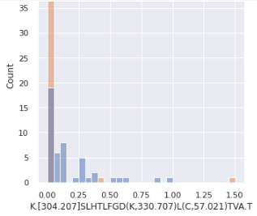
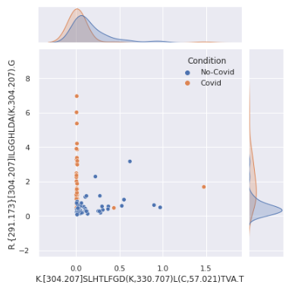
Visualizing Disease and class association

Slide 14
Assessment on protein identification - Model 1
K.[304.207]GLEWVSGISWNSG(S,-0.934)IGYA.D
K.[304.207]EFNAE(T,-18.005)FTFH.A
K.[304.207]SL(H,57.024)TLFGD(K,304.207).L
sp|P01782|HV309_HUMAN
K.[304.207](L,-13.033)VNEVTEFA(K,304.207).T
sp|P02768|ALBU_HUMAN
K.[304.207](S,300.207)LHTLFGD(K,304.207).L
sp|P02647|APOA1_HUMAN
K.[304.207]DVFLG(M,16.508)FLYEYAR.R
K.{29.027}[304.207]T(C,57.021)VADESAEN(C,57.021)D(K,304.207).S
sp|P02787|TRFE_HUMAN
K.[304.207]LLDN(W,19.997)DSVTSTFS(K,304.207).L
A.[304.207]VSEHEAT(K,304.207).C
M.[304.207](P,39.161)ADLPSLAADFVES(K,304.207).D

Slide 15
Assessment on protein identification - Model 2
K.[304.207]SLHTLFGD(K,332.213)L(C,57.021)TVA.T
K.[304.207](S,143.085)LHTLFGD(K,304.207).L
R.{291.173}[304.207]ILGGHLDA(K,304.207).G
sp|P02768|ALBU_HUMAN
K.[304.207]SLHTLFGD(K,330.707)L(C,57.021)TVA.T
sp|P00738|HPT_HUMAN
A.[304.207]VDSGNDVTDIADDG(C,57.021)P(K,304.207)PPEIAHGYVEHSVR.Y
tr|A0A087WWT3|A0A087WWT3_HUMAN
K.[304.207](Y,265.169)TYETTLE(K,304.207).C
R.[304.207]VGYVSG(W,13.983)GR.N
tr|A0A0C4DGB6|A0A0C4DGB6_HUMAN
K.[304.207]ADD(K,304.207)ET(C,57.021)FAEE(P,184.096)TMRIRER(K,304.207).-
E.[304.207](C,28.639)FLQH(K,304.207)DDNPNLPR.L
K.[304.207](S,172.068)LHTLFGD(K,304.207).L
Notes:
sp|P02768|ALBU_HUMAN has 4 peptides mapped to it
sp|P00738|HPT_HUMAN has 3
other two only one each

Slide 16
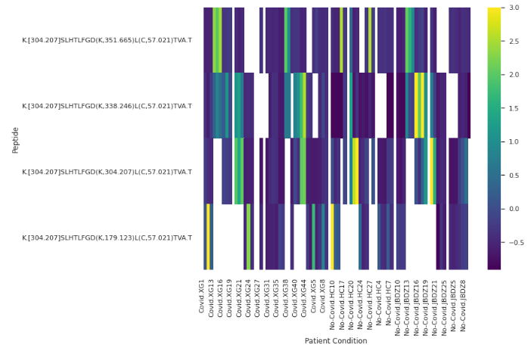
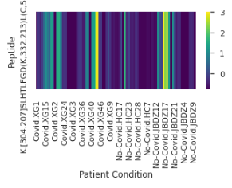
Assessment on peptide/variant-level DA
Variant-Level
Peptides: K.[304.207]SLHTLFGD(K,332.213)L(C,57.021)TVA.T
K.[304.207]SLHTLFGD(K,330.707)L(C,57.021)TVA.T
gjehgfuegfgihfirfhirufhiriu
Unmod sequence: .SLHTLFGDKLCTVA.
75% other modified variants of the same sequence are not DA
p = 0.12
Unmodified peptide is not DA

Slide 17
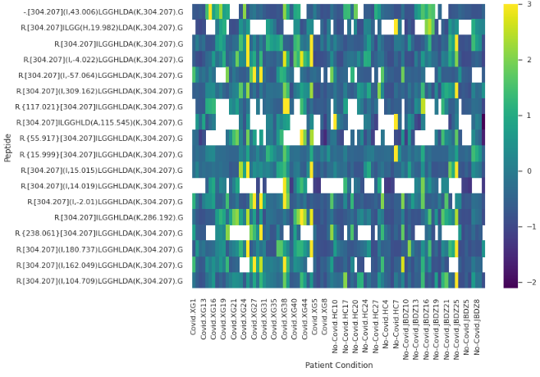
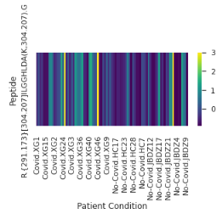
Assessment on peptide/variant-level DA
Not variant level
Peptide: R.{291.173}[304.207]ILGGHLDA(K,304.207).G
gjehgfuegfgihfirfhirufhiriusd
gjehgfuegfgihfirfhirufhiriu
62% other peptides of the same sequence are not DA (after we removed peptides with > 45 missing values)
p = 1.48e-11
Unmodified peptide is DA

Slide 18
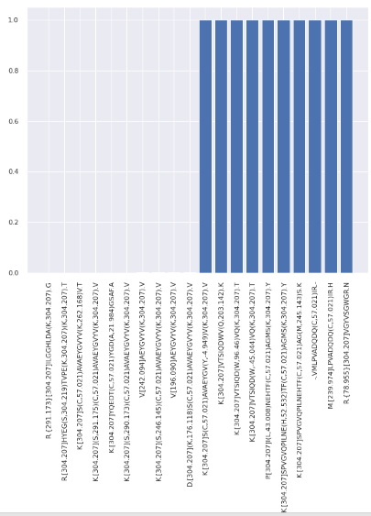
Assessment on peptide/variant-level DA
Peptide-Level
p
gjehgfuegfgihfirfhirufhiriu
Top protein: sp|P00738|HPT_HUMAN
850 peptides of same protein with p < 0.05
1937 peptides of same protein with p > 0.05
56% other peptides for the same protein are not DA (after we removed peptides with > 45 missing values)

Slide 19
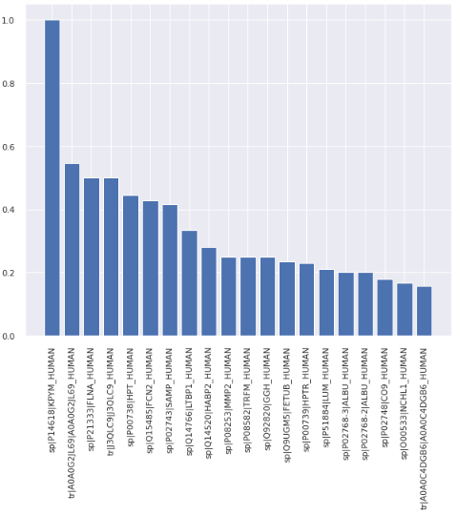
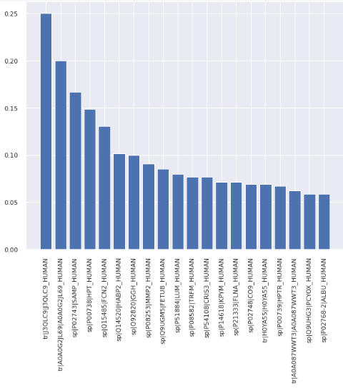
Assessment on protein-level DA
No protein-level DA
%
%
gjehgfuegfgihfirfhirufhiriusd
For each protein:
Remove peptides with > 45 NAs
Find count of peptides with p<0.05
percent = count/(#peptides after 1.1)
if percent > 0.5, protein-level
For each protein:
Remove peptides with > 45 NAs
Find count of peptides with p<0.05
percent = count/(#peptides)
if percent > 0.5, protein-level

Slide 20
Assessment on peptide/variant identification - Model 1
Feature Peptide (A) | Explained intensity | MassIVE Reference Peptide (B) | Cosine similarity (A,B) | Link/Comments
K.[304.207]EFNAE(T,-18.005)FTFH.A | 64.62% | EFNAETFTFH | 0.7156 | Metabolomics link
K.[304.207](S,300.207)LHTLFGD(K,304.207).L | 32.84% | SLHTLFGDK | 0.2508 | Metabolomics link
M.[304.207](P,39.161)ADLPSLAADFVES(K,304.207).D | 36.83% | PADLPSLAADFVESK | 0.2057 | Metabolomics link
K.[304.207](L,-13.033)VNEVTEFA(K,304.207).T | 49.15% | LVNEVTEFAK | 0.1273 | Metabolomics link
Notes:
EFNAETFTFH
Found it in the immunogen sequence of a thermofisher albumin antibody. Decreased levels of serum albumin are reported in patients with severe forms of myocardial infarction, stroke, hip fracture, malignancy, and renal disease.
Hypoalbuminemia has been associated with morbidity and mortality in hospitalized patients, especially in icu patients having a severe form of covid 19.

Slide 21
Assessment on peptide/variant identification - Model 1
Feature Peptide (A) | Explained intensity | Reference Peptide (B) | Explained intensity | Cosine similarity (A,B) | Link
K.[304.207]EFNAE(T,-18.005)FTFH.A | 64.62% | K.[304.207]EFNA(E,-17.003)TFTFH.A | 59.77% | 0.9949 | Metabolomics link
K.[304.207](S,300.207)LHTLFGD(K,304.207).L | 32.84% | K.[304.207](S,260.115)LHTLFGD(K,304.207).L | 40.83% | 0.6342 | Metabolomics link
M.[304.207](P,39.161)ADLPSLAADFVES(K,304.207).D | 36.83% | M.[304.207](P,30.6)ADLPSLAADFVES(K,304.207).D | 29.31% | 0.639 | Metabolomics link
K.[304.207](L,-13.033)VNEVTEFA(K,304.207).T | 49.15% | K.[304.207](L,-15.04)VNEVTEFA(K,304.207).T | 57.63% | 0.3707 | Metabolomics link

Slide 22
Assessment on peptide/variant identification - Model 2
Feature Peptide (A) | Explained intensity | MassIVE Reference Peptide (B) | Cosine similarity (A,B) | Link/Comments
K.[304.207](S,143.085)LHTLFGD(K,304.207).L | 18.68% | SLHTLFGDK | 0.1446 | Metabolomics link
R.[304.207]VGYVSG(W,13.983)GR.N | 30.03% | VGYVSGWGR | 0.0366 | Metabolomics link
K.[304.207](S,172.068)LHTLFGD(K,304.207).L | 29.61% | SLHTLFGDK | 0.1827 | Metabolomics link

Slide 23
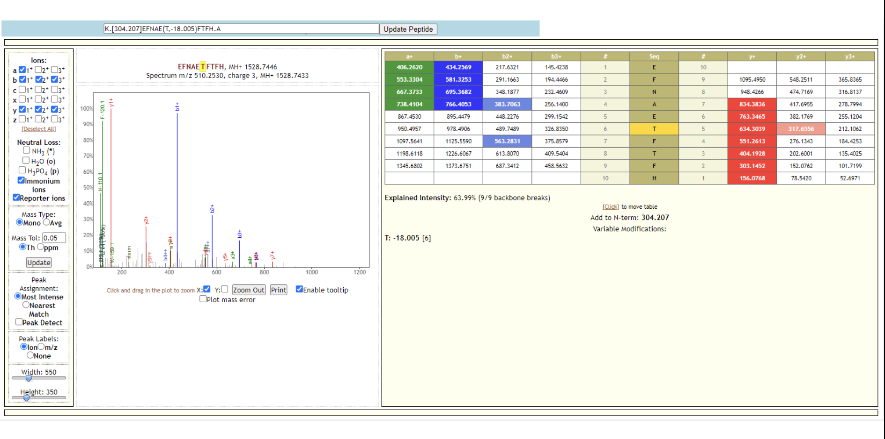
Assessment on peptide/variant identification - Model 1
Confirming spectrum identification
K.[304.207]EFNAE(T,-18.005)FTFH.A

Slide 24
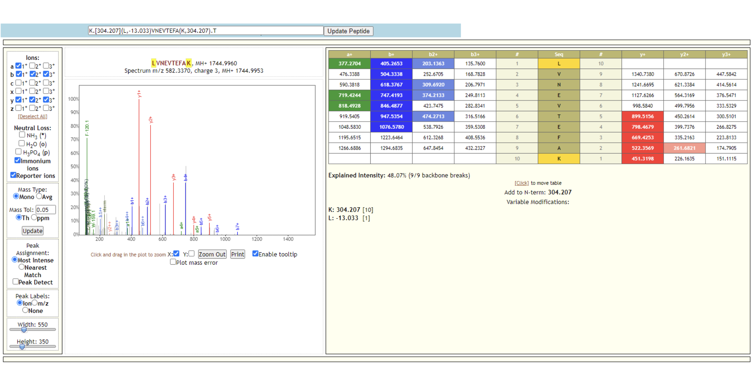
Assessment on peptide/variant identification - Model 1
K.[304.207](L,-13.033)VNEVTEFA(K,304.207).T

Slide 25
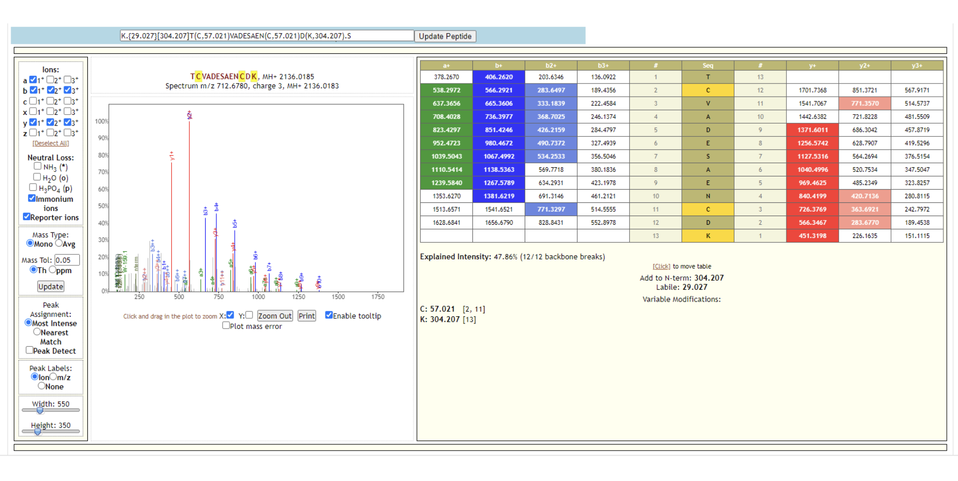
Assessment on peptide/variant identification - Model 1
K.{29.027}[304.207]T(C,57.021)VADESAEN(C,57.021)D(K,304.207).S

Slide 26
Assessment on peptide/variant identification - Model 1
Qualitative labeling of modifications
Peptide | Unmodified peptide | Common substitution mass | Peptide Modifications | Comments | UNIMOD link
K.[304.207]EFNAE(T,-18.005)FTFH.A | EFNAETFTFH | -18 | 298 (-18 @ T) | Dehydration | UNIMOD link
K.[304.207](S,300.207)LHTLFGD(K,304.207).L | SLHTLFGDK | 300 | 41 (300 @ S) | TMTpro 16plex Tandem Mass Tag | UNIMOD link
M.[304.207](P,39.161)ADLPSLAADFVES(K,304.207).D | PADLPSLAADFVESK | 40 | 18 (40 @ P) | Pro->His substitution | UNIMOD link
R.[304.207]VGYVSG(W,13.983)GR.N | VGYVSGWGR | 14 | 103 (14 @ W) | Proline oxidation to pyroglutamic acid | UNIMOD link

Slide 27
Supplementary Slides

Slide 28
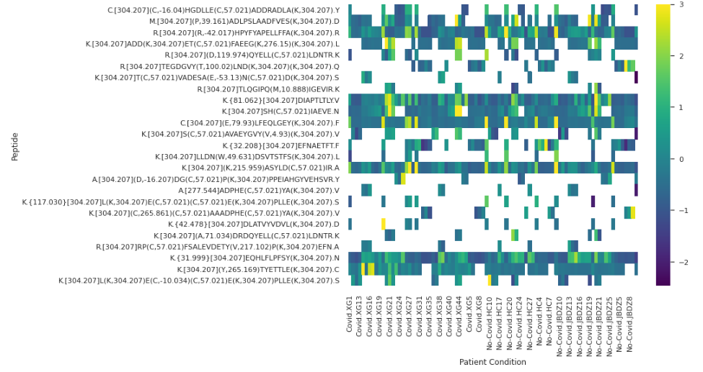
Assessment on peptide/variant-level DA - Model 1
Top 25 with missing values

Slide 29
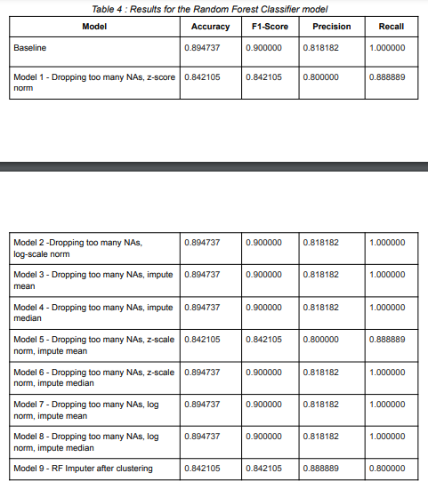
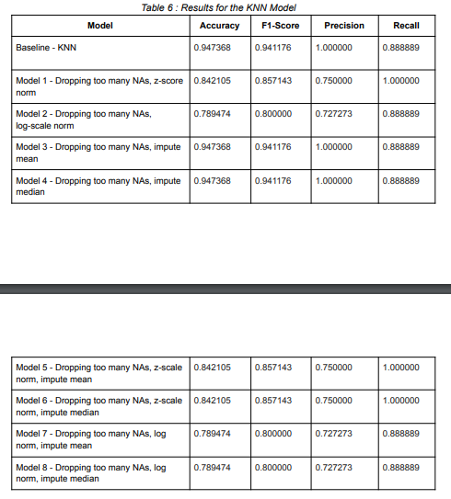

Slide 30
Challenges (or limitations) and future work
Some of the challenges were:
Processing and modeling a dataset with a large number of features was difficult. Since we transposed the data, here, there are 101461 columns. These account for the peptide intensities; feature selection and feature importances were more difficult to narrow down with such a huge number.
There were also a large number of missing values; we had to make sure to carefully handle these in our processing at different points (for example, during clustering). We can sense from the good performance of the baseline models that missing values are possibly impacting the classification.
Moreover, with only 90 samples, the train and test samples are also very small in number. This means there is a high possibility of overfitting.

Slide 31
Thank You!

Slide 32
Final feature selection/processing
Only use columns with “[patient_condition]..intensity_for_peptide_variant”, dropping two samples (Empty and Norm)
Transpose the matrix
Add column Condition - “Covid” and “No-Covid”
Add column Original Class - original condition of the sample (4 from dataset)
Handling Missing Values (in train):
Model 1 -
MissForest imputer to impute values using canonical proteins
Dataset grouped by canonical proteins
Final number of features: 101464 peptide variant intensities
Model 2 -
Remove peptides with too many NAs
Perform log normalization
Impute mean only using train, store the mean for each peptide to replace NAs in test
Final number of features: 100187 peptide variant intensities

Slide 33
Evaluation of the models
Results:
Model 1 : Imputing values using MissForest
Model 2: Dropping peptides with too many NAs, log norm, imputing values using mean
Model | Accuracy | F1 Score | Precision | Recall
Model 1 | 0.89 | 0.88 | 1.00 | 0.80
Model 2 | 0.89 | 0.90 | 0.81 | 1.00

Slide 34
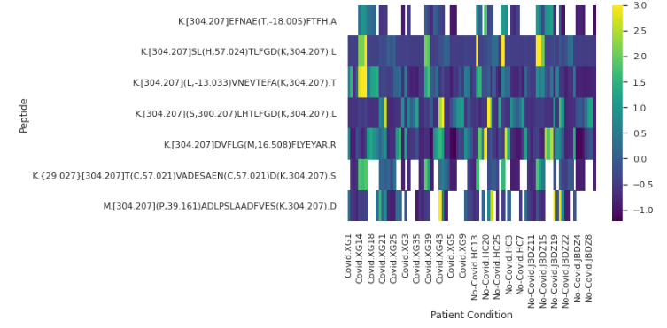
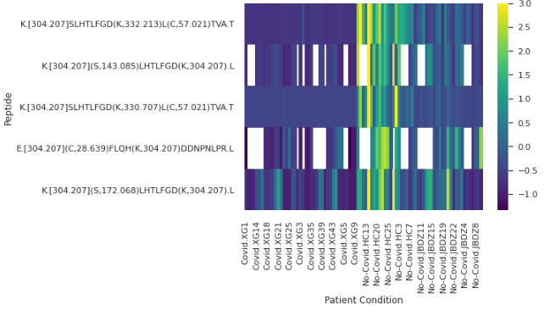
Assessment on protein-level differential abundance
Top protein: sp|P02768|ALBU_HUMAN
Top protein: sp|P02768|ALBU_HUMAN
Model 1
Model 2

Slide 35
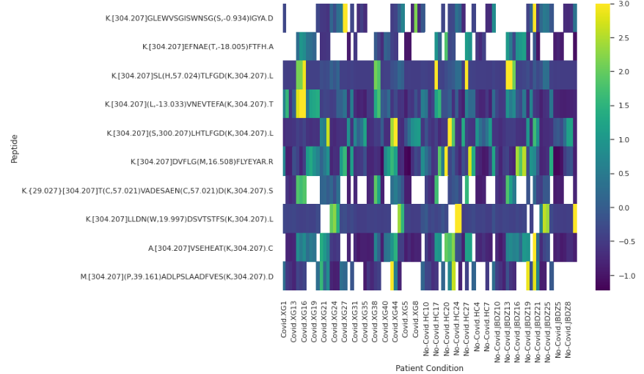
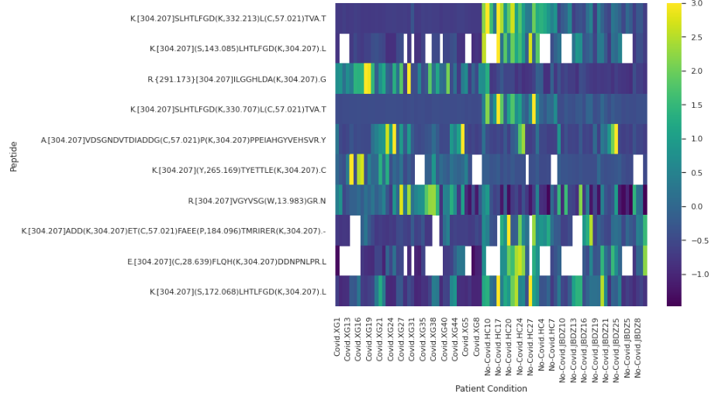
Assessment on peptide/variant-level DA
Model 1
Model 2
Top features with < half missing values
Not many missing values

Slide 36
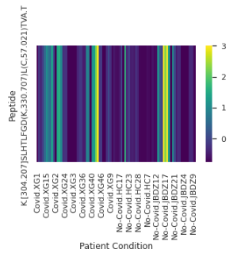
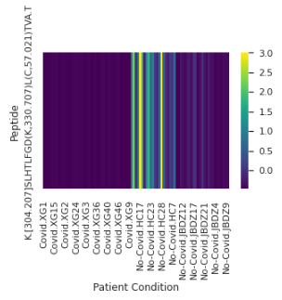
Assessment of peptide/variant-level DA - Model 2
Unmodified sequence Modified Sequence

Slide 37
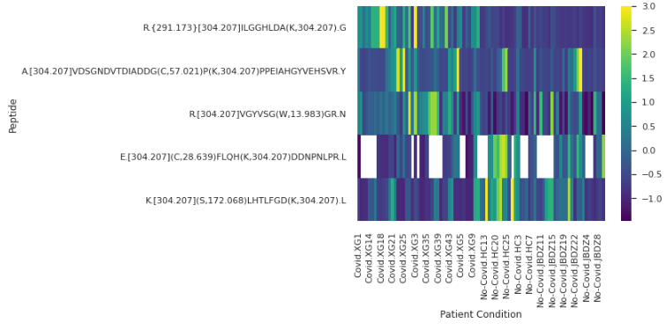
Assessment on protein-level differential abundance - Model 2
Top protein: sp|P00738|HPT_HUMAN

Slide 38
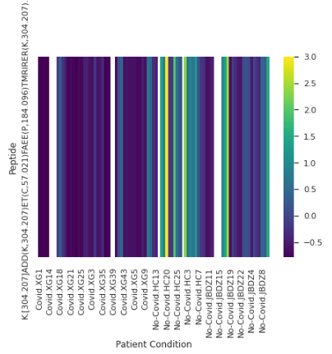
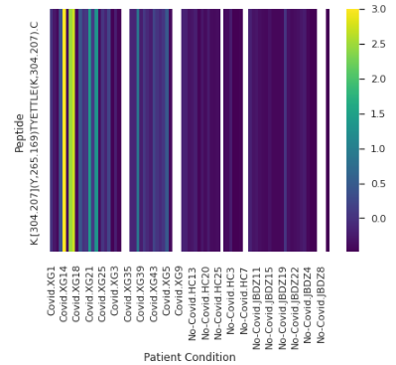
Assessment on protein-level differential abundance - Model 2
Top protein: tr|A0A087WWT3|A0A087WWT3_HUMAN Top protein: tr|A0A0C4DGB6|A0A0C4DGB6_HUMAN

